Slide 1
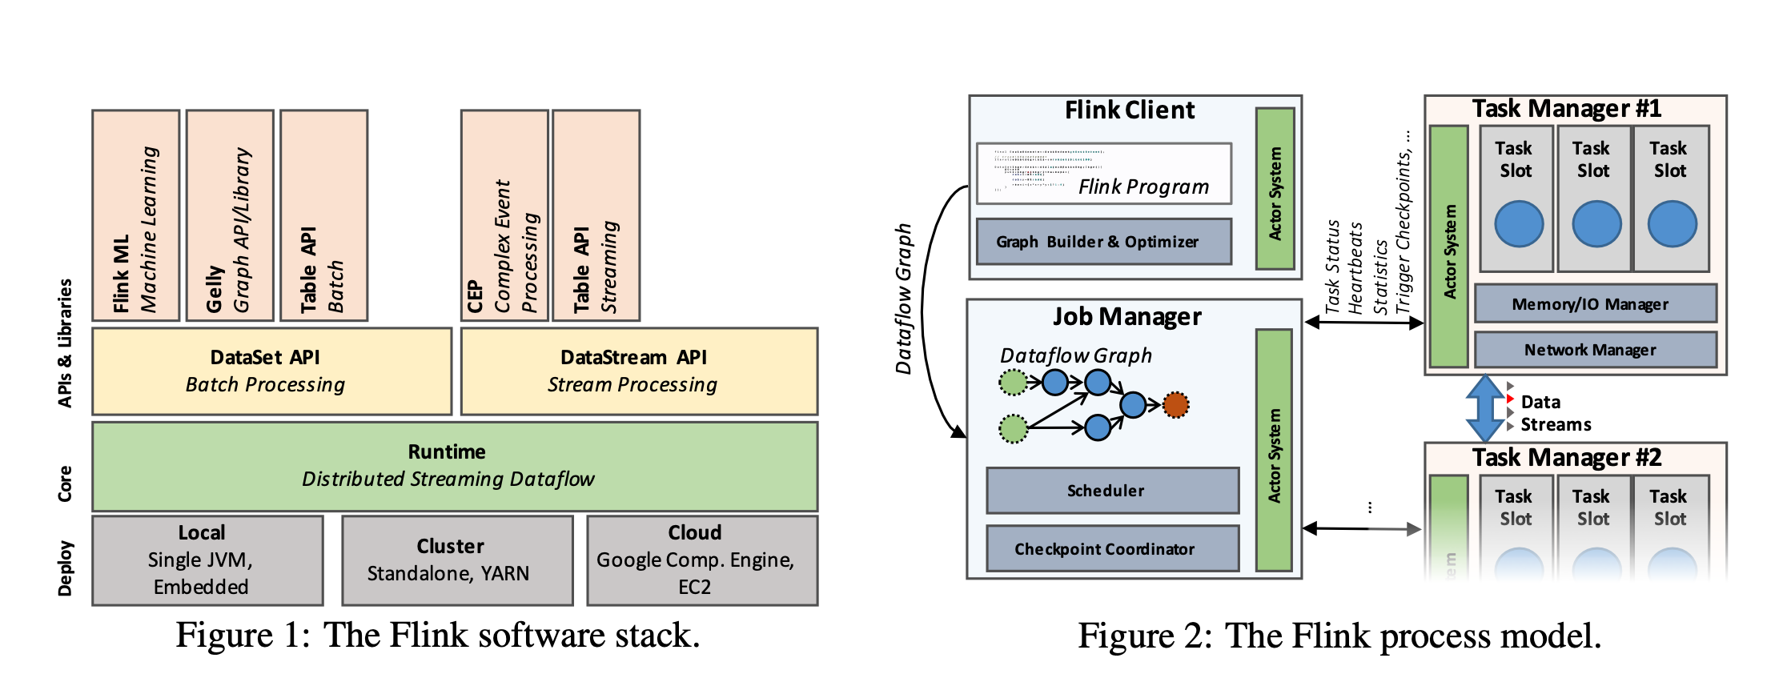
Notes:
why flink?
stream first principle ， real streaming processing engine. consider batch as a 特殊streaming.
stack
三层, clear abstraction. deploy, core, api
api, 生成运行计划.
tramsormation. program 生成stream data flow
source -> sink, 可以是HDFS files, kafka data, text. csv, hadoop. HBase.
数据- > flat map, ma, keyby, window 等操作, -> HDFS
client : 提交job
jobmanage : 管理task manger,
resource manager, 调度分配 allocate, scheduling
task manager: 一个应用可以分解给多个task manager 来计算.

Slide 2
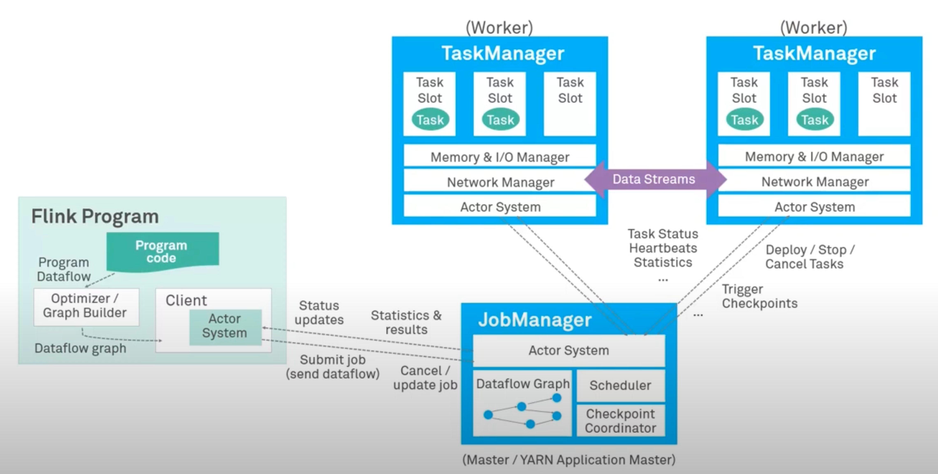
Notes:
每个work 也叫task manager都是一个JVM, 可能多线程执行subtask. work有多个task slot, taskslot 资源的子集. 比如可以把内存分成三份, 3个slot. 但是不分CPU . 就是3个subtask share same JVM, share TCPconnection和heartbeat.

Slide 3
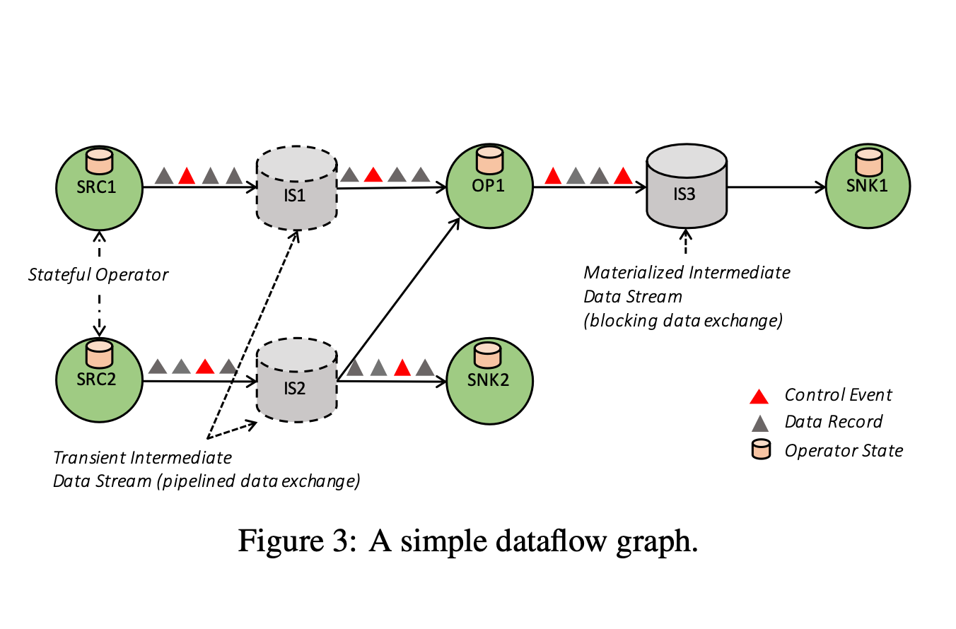

Slide 4
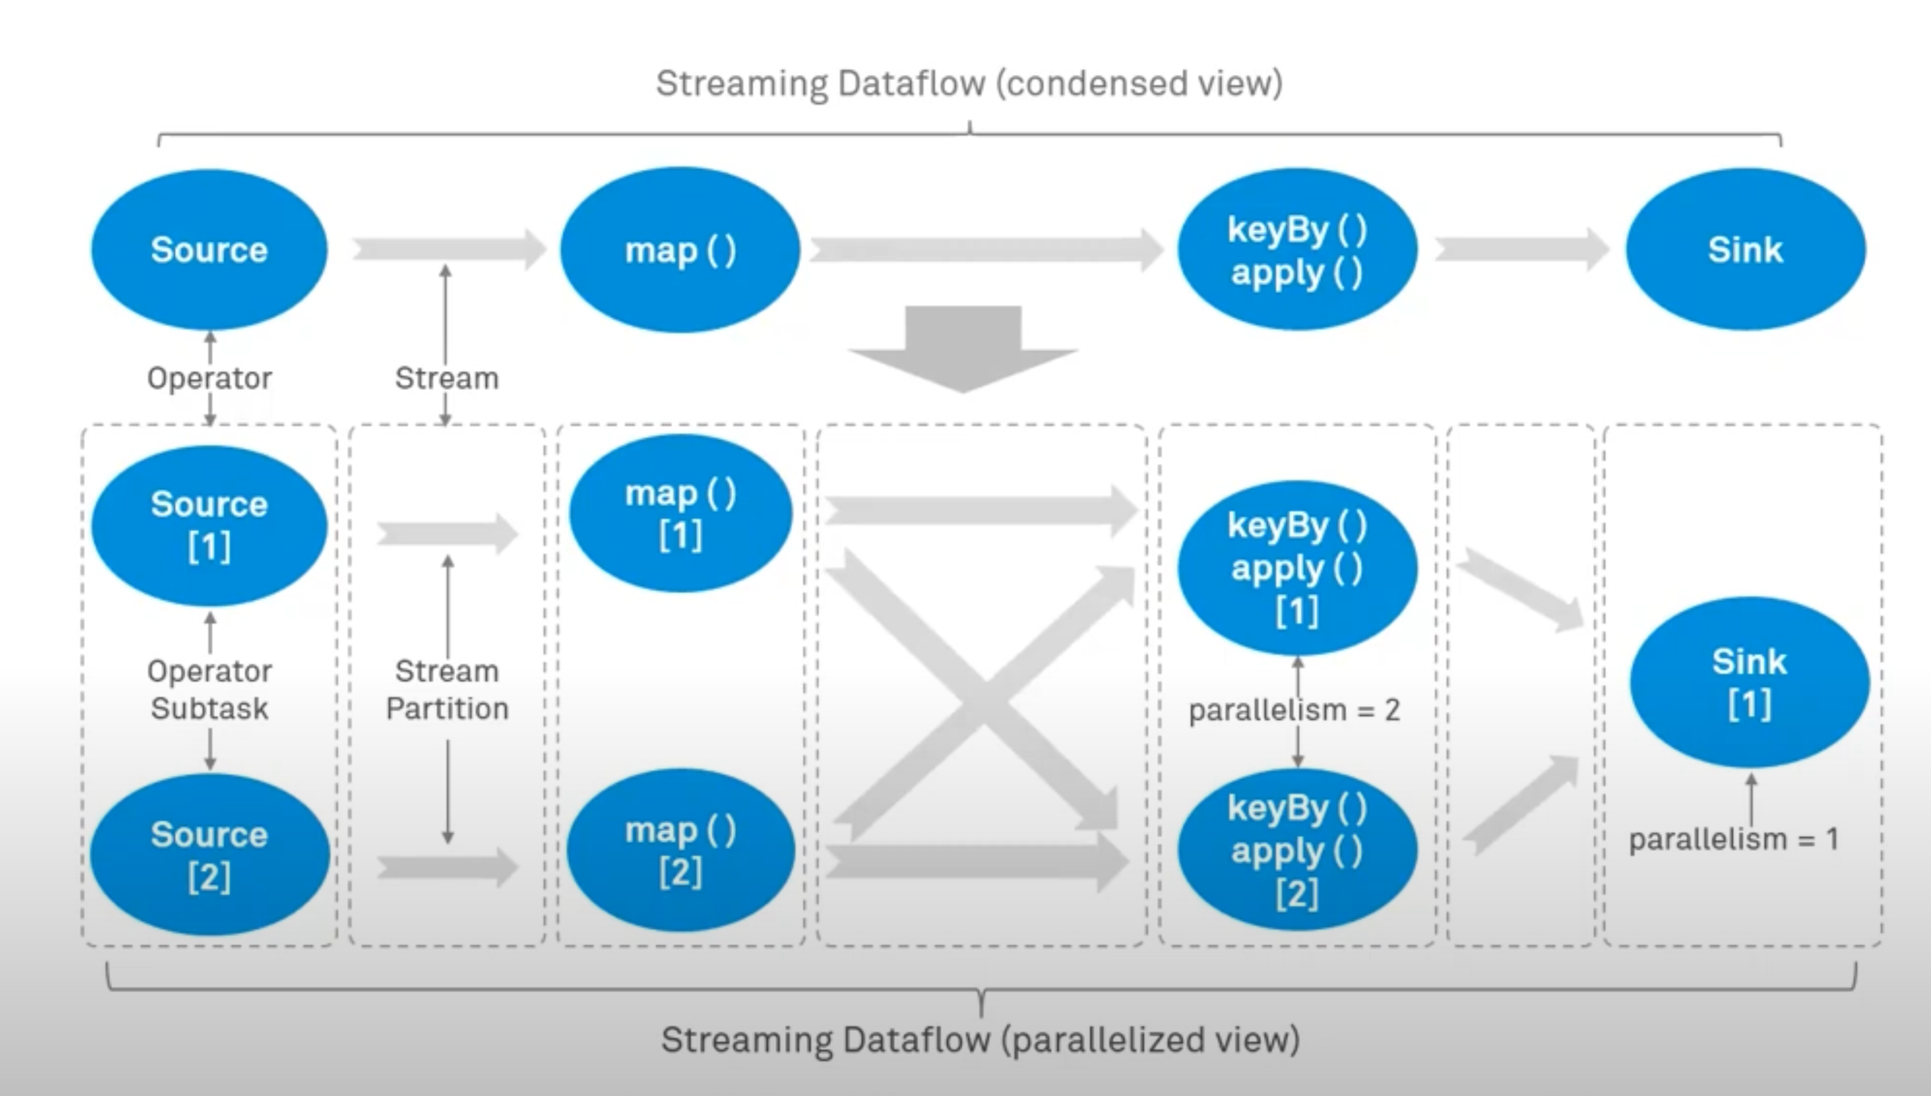
Notes:
Operation chain. Other can parallel, but parallisim of sink is one .

Slide 5
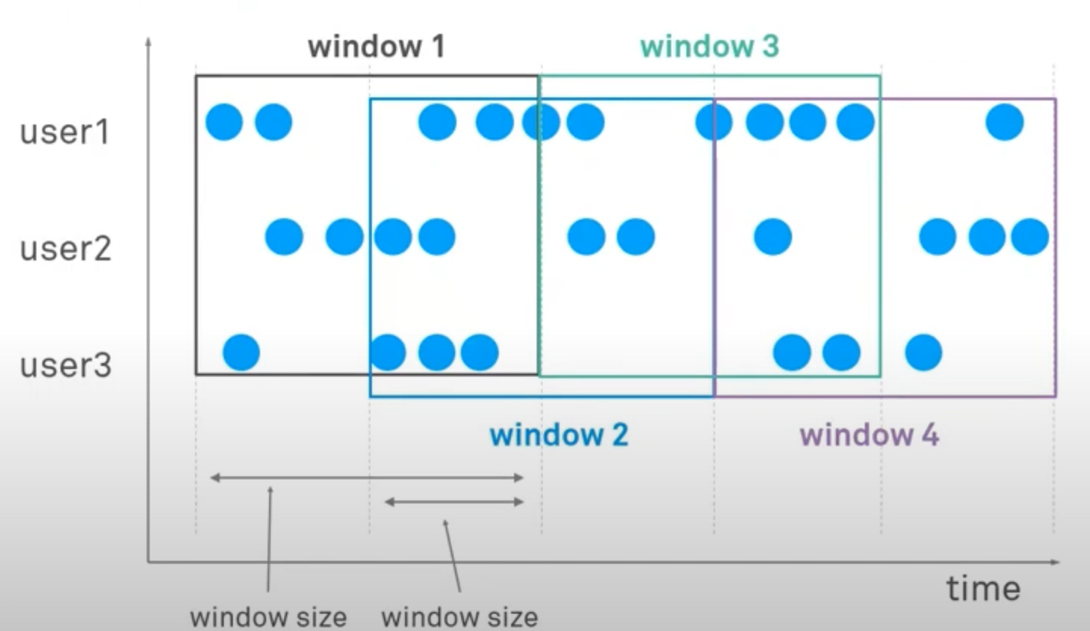
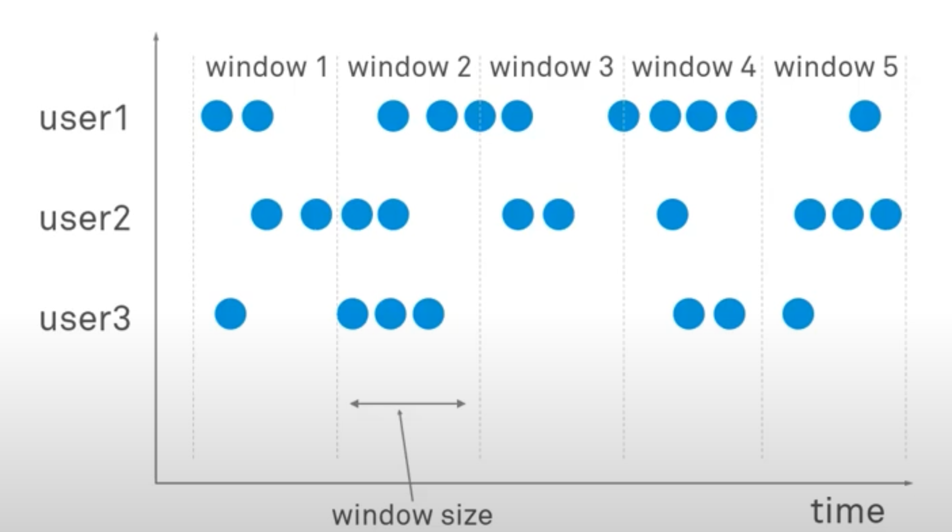
Tumbling window
Sliding window
Notes:
windows
time driven or data driven ,eg. every 100 element.
tumbling windows, times do not overlap
sliding windows, windows size changes , time overlap /
session window,

Slide 6
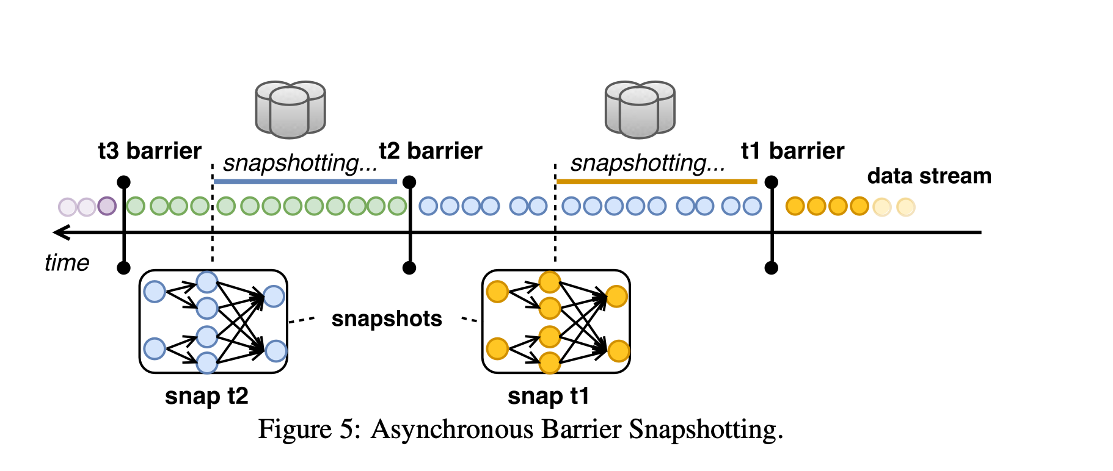
Notes:
barrier
CL 算法, barrier inject into flow . barrier, don't interrupt flow of stream, so lightweight.

Slide 7
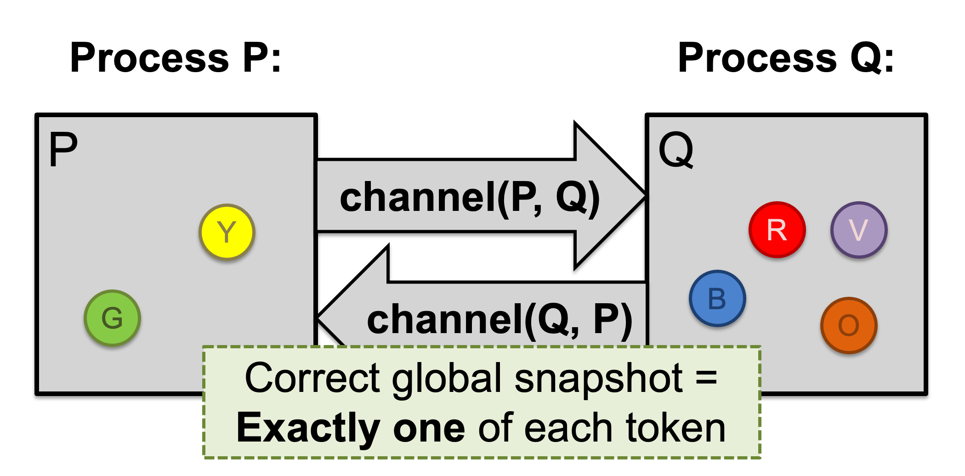
CL algorithm

Slide 8
Idea: “Marker” messages
We should have captured the state of the channels as well
Chandy-Lamport algorithm
Let’s send a marker message ▲ to track this state
Not an application message, does not interfere with other application messages
Channels deliver marker and other messages FIFO
Notes:
checkpointcordinator ,send barrier to all source op of streaming application.

Slide 9
Chandy-Lamport: Sending process
P snapshots and sends marker, then sends Y
Send Rule: Send marker on all outgoing channels
Immediately after snapshot
Before sending any further messages
P
Q
Y
▲
Y
R
V
B
G
O
snap: P = { G, Y }
Notes:
source operation create a snapshot of his current status ,persistent . notify coordinator, it created.

Slide 10
Chandy-Lamport: Receiving process (1/2)
At the same time, Q sends orange token O
Then, Q receives marker ▲
Receive Rule (if not yet snapshotted)
On receiving marker on channel c record c’s state as empty
channel(P,Q) = { }
P
Q
Y
▲
▲
R
V
B
G
O
O
P = { G, Y }
Q = { R, V, B }
Notes:
broadcast barrier to all downstream operators. and resume data processing

Slide 11
Chandy-Lamport: Receiving process (2/2)
Q sends marker to P
P receives orange token O, then marker ▲
Receive Rule (if already snapshotted):
On receiving marker on c record c’s state: all msgs from c since snapshot
channel(P,Q) = { }
P
Q
Y
O
▲
R
V
▲
B
G
O
P = { G, Y }
channel(Q,P) = { O }
Q = { R, V, B }
Notes:
until barrier sent to sink op . Coorditor receive all report.

Slide 12
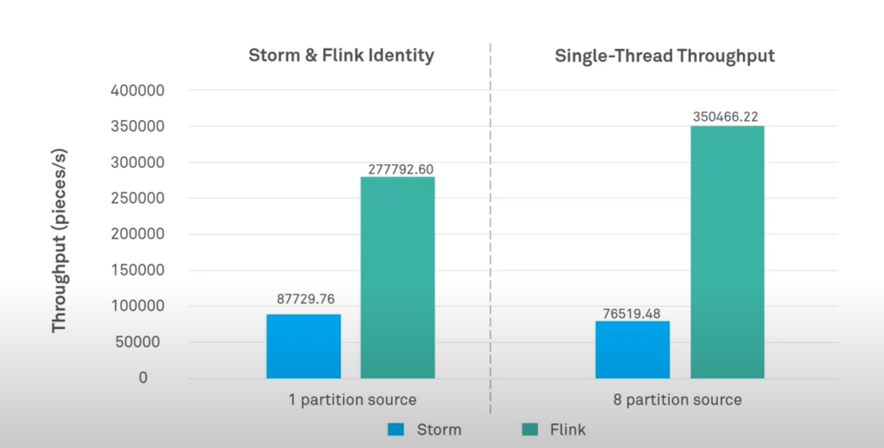
performance

